Slide 1

Project Title -Healthcare Analytics for Doctor Visits
Student Name- Harshada Nanabhau Mali
College Name- R. C. Patel Educational Trust's Institute of Management Research and Development, Shirpur
AICTE STU ID :STU6a5a433eac6fd1784300350

Slide 2
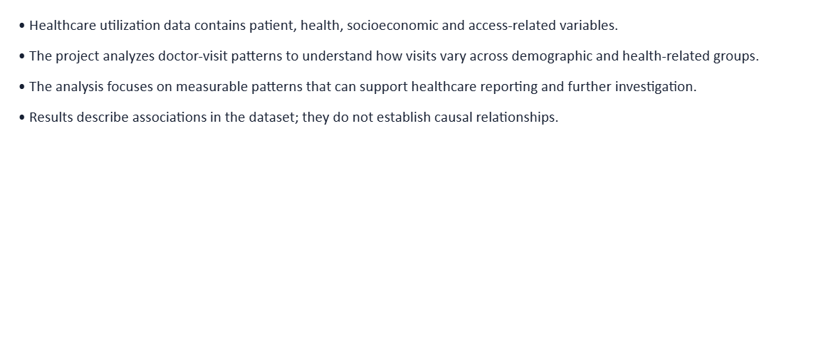

PROBLEM STATEMENT

Slide 3
Project Description
Healthcare Analytics for Doctor Visits is a Python-based data analysis project
Workflow:
Raw Dataset → Data Understanding → Data Cleaning → Feature Engineering → Statistical Analysis → Visualization → Insights
The project creates additional analytical fields such as:
Age_Years
Age_Group
Any_Chronic_Condition
Any_Healthcare_Coverage
The analysis includes demographic, health, insurance, income, correlation, and cross-analysis.

Slide 4

WHO ARE THE END USERS?
Doctors & Healthcare Professionals – Analyze patient visits, illness, health, and chronic conditions.
Hospital & Clinic Managers – Monitor healthcare utilization and patient patterns.
Healthcare Analysts – Identify trends and relationships in patient data.
Healthcare Policy & Planning Teams – Use insights for healthcare planning and resource allocation.
Researchers & Students – Study healthcare utilization and patient behavior.

Slide 5

Technology Used
Python
Core programming and analysis
Pandas
Data loading, cleaning and transformation
NumPy
Numerical operations and feature engineering
Matplotlib
Data visualization
Seaborn
Statistical visualization
These are the tools specified in the project source.

Slide 6
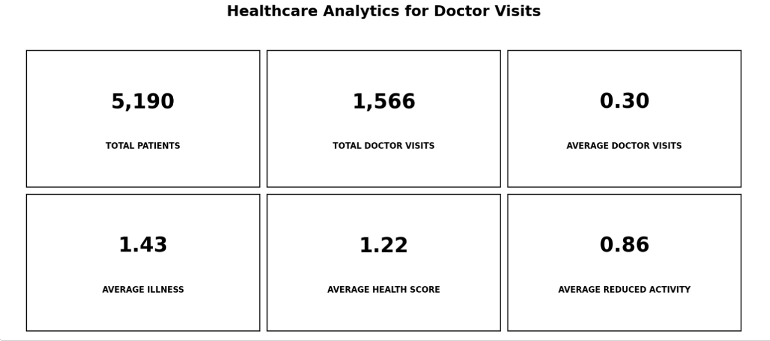
RESULTS
Demo Link

Slide 7
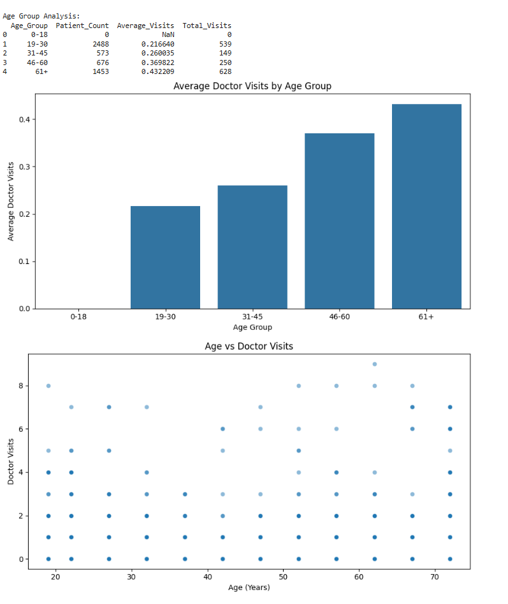
RESULTS
[Add screen shots of your code ]

Slide 8
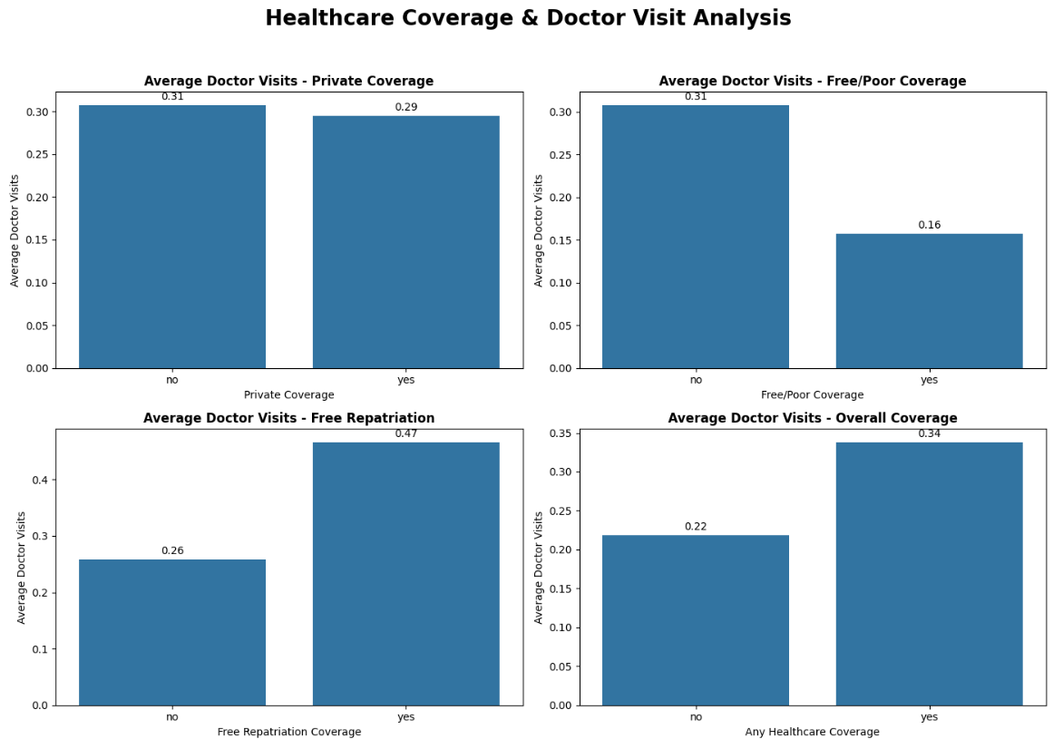
RESULTS
[Add screen shots of your code ]

Slide 9
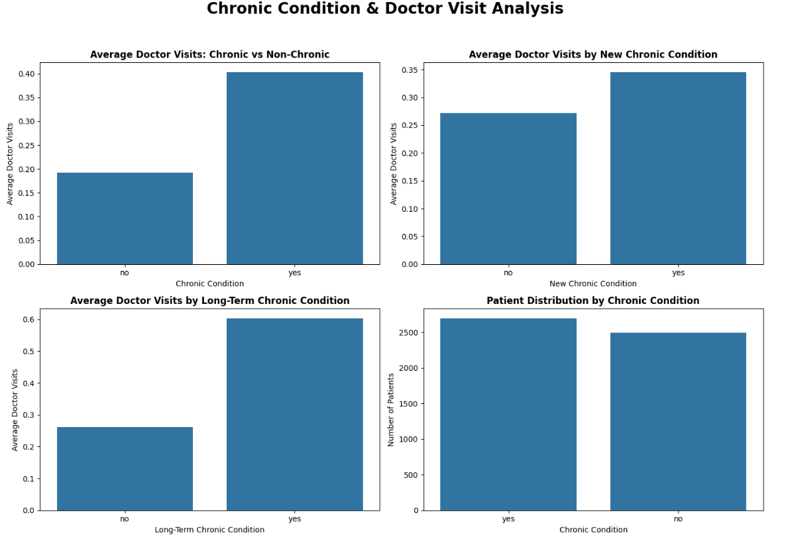
RESULTS
[Add screen shots of your code ]
Demo Link

Slide 10
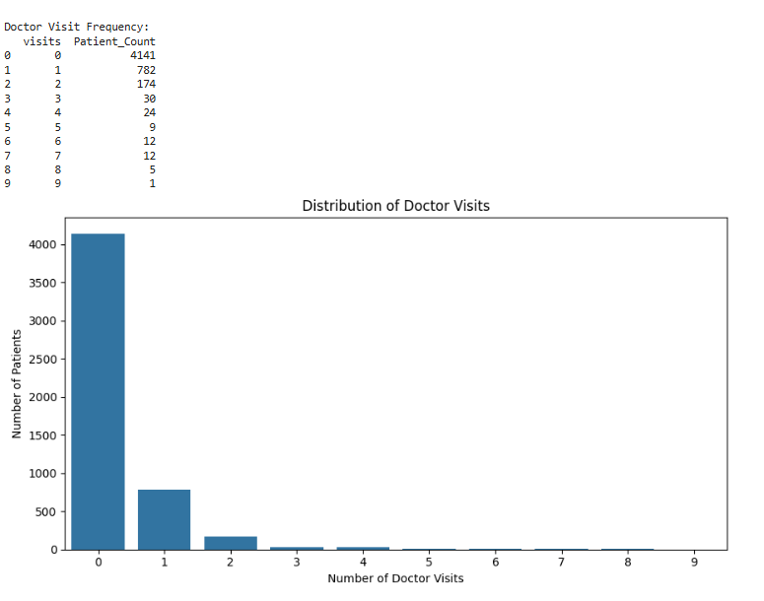
RESULTS
[Add screen shots of your code ]

Slide 11
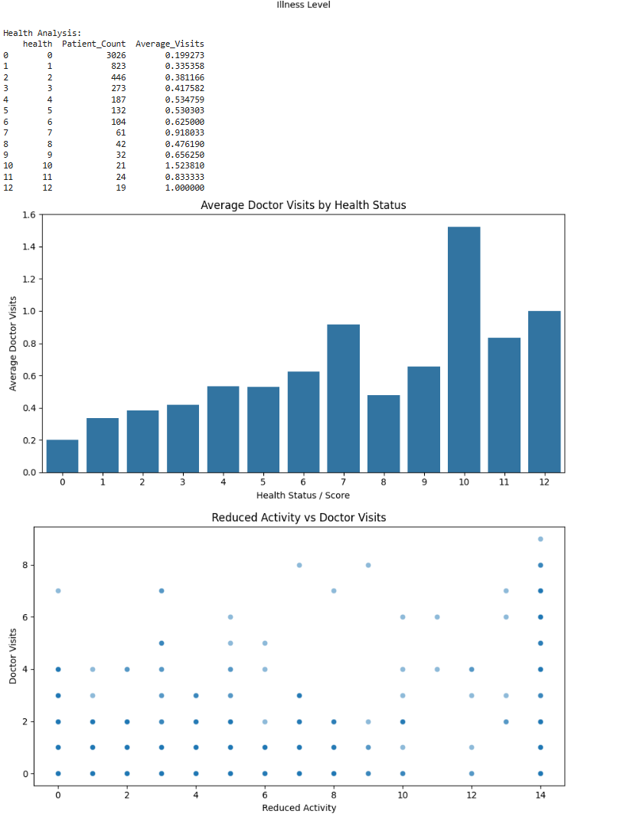
RESULTS
[Add screen shots of your code ]

Slide 12
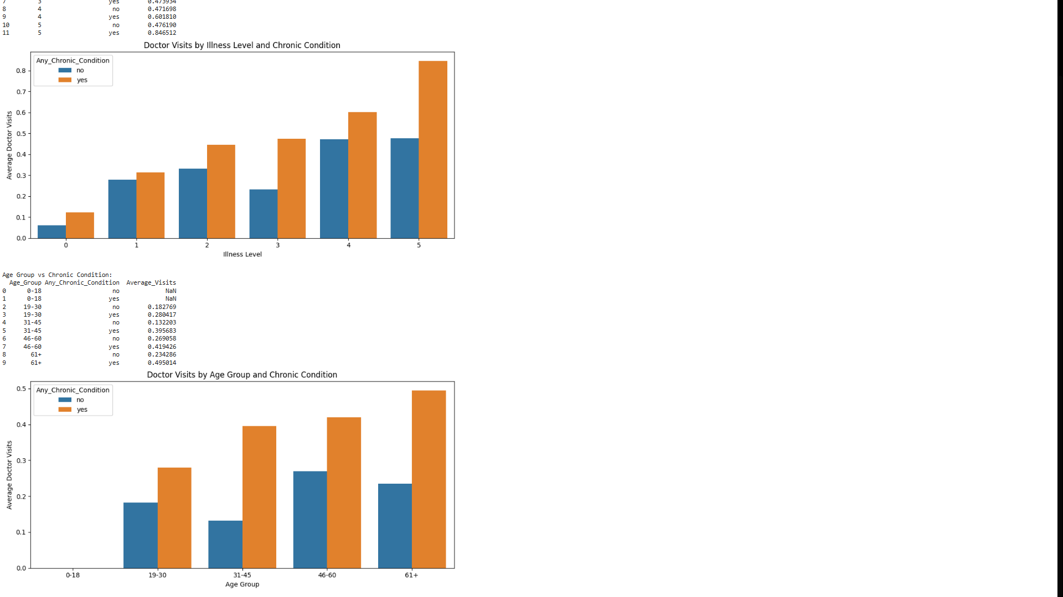
RESULTS
[Add screen shots of your code ]

Slide 13
Thank you
.
.

